Slide 1

APPLIED MACHINE LEARNING FOR TEXT ANALYSIS
(PROJECT PRESENTATION)
Project Name : LLM-Based Intelligent Personal Finance Advisor with Personalized Savings Prediction and Investment Recommendation
Team Members:
1) 2420030610 - Ch. Srikar
2) 2420030406 – K. Narasimha Sai
3) 2420080075 – D. Hari Haran
4) 2420080039 – P. Jyothik Kshitij

Slide 2
Problem Statement
People struggle to track and manage their daily expenses.
Existing finance apps provide limited personalized financial guidance.
Users often cannot estimate how much they can realistically save each month.
Many people are unsure how to invest their savings based on their financial situation and risk level.
An intelligent system is needed to predict savings and recommend suitable investments with personalized AI advice.

Slide 3
Objectives
1)To integrate users' income and expenditure patterns to understand their financial
behaviour.
2) To develop a Machine Learning model to predict users' monthly savings.
3) To identify unnecessary expenses and provide personalized budgeting suggestions.
4) To generate a Financial Health Score based on the user's financial condition.
5) To recommend suitable investment opportunities based on the user's available savings
and risk profile.
6) To provide personalized financial guidance using an LLM for easy understanding.

Slide 4
Literature Survey
Research Papers | Key Contributions | Limitations
WeFinance: AI-Powered Personal Finance Assistant ML Model : GPT-4o Vision | Uses GPT-4o Vision for bill recognition, expense analysis, conversational financial advice, anomaly detection, and explainable investment recommendations. | Does not provide ML-based monthly savings prediction or a dedicated financial health score.
Can LLMs be Good Financial Advisors? (2023) ML Model : Google Bard | Evaluates LLMs for personal financial decision-making, including banking, purchases, payments, and investment advice | LLM responses can be fluent but still have accuracy and reliability limitations; it does not build a complete personal finance management system.
Large Language Models in Finance(2023) ML Model : Pre-trained LLMs, Fine-tuned LLMs & Custom LLMs | Reviews LLM applications in finance, including zero-shot, few-shot, and fine-tuned approaches. | Provides a broad survey but does not implement an end-to-end personal finance advisor.
Can AI Help with Your Personal Finances? (2024) ML Model : Gemini, Claude & Llama | Compares ChatGPT, Gemini, Claude, and Llama for personal finance questions such as taxes, loans, mortgages, and investments. | Evaluates existing LLMs but does not integrate them with a user's financial dataset and ML savings prediction.
Investor Behavior Modeling Using Machine Learning (2021) ML Model : Supervised Machine Learning + NLP | Uses NLP and supervised machine learning to model investor behavior and identify financial coaching needs. | Focuses on investor behavior rather than income/expense analysis and monthly savings prediction.

Slide 5
Literature Survey
Research Papers | Key Contributions | Limitations
Are Generative AI Agents Effective Personalized Financial Advisors? (2025) ML Model : LLM-based Generative AI Agents | Investigates how generative AI agents can provide personalized financial recommendations | Focuses on evaluating personalized AI advice rather than combining financial-health analysis with savings prediction.
How Individuals Use Generative AI for Personal Financial Management (2026) ML Model : ChatGPT / LLMs | Studies how people use LLMs for investment, savings planning, budgeting, tax filing, and other financial tasks. | Studies user behavior and adoption rather than developing an integrated ML + LLM financial advisor.
How Individuals Use Generative AI for Personal Financial Management (2026) ML Model : XgBoost and NLP | Studies how people use LLMs for investment, savings planning, budgeting, tax filing, and other financial tasks. | Studies user behavior and adoption rather than developing an integrated ML + LLM financial advisor.
Financial Advice Behaviour: Humans versus AI (2026) ML Model : ChatGPT & Gemini | Compares financial recommendations from human advisors and LLMs and examines differences in portfolio recommendations. | Focuses on comparing advice quality rather than building a personalized savings prediction and financial-health system.
GPT Has Become Financially Literate (2023) ML Model : Random Forest Regressor | Evaluates GPT-3.5 and GPT-4 on financial literacy and their potential as financial advisors. | Focuses on financial knowledge and advice rather than personalized savings prediction and expense-based financial planning.

Slide 6
Innovation
Machine Learning-based monthly savings prediction, which is not available in WeFinance.
Financial Health Score generation to assess the user's financial condition.
Personalized budget planning based on income and expenditure patterns instead of only bill analysis.
LLM-powered financial guidance that explains recommendations in simple, natural language.
Future savings forecasting to help users plan their finances proactively.
Integration of Machine Learning and LLM into a single intelligent financial advisory system.
7) Personalized investment recommendations based on predicted savings and the user's financial profile

Slide 7
Research Gap Identification
1)Existing systems mainly focus on expense tracking and bill analysis rather than comprehensive income–expense analysis.
2)Limited systems provide personalized monthly savings prediction using Machine Learning.
3)Most existing solutions do not provide a Financial Health Score based on the user's overall financial condition.
4)Existing financial assistants often provide general financial advice rather than recommendations based on individual financial data.
5)Limited integration of ML-based financial prediction with LLM-based personalized guidance exists in current solutions.
6)Existing studies focus separately on LLM financial advice, investment behavior, or budgeting, rather than combining these capabilities.
7)There is a need for personalized budget planning based on users' income, expenses, and spending patterns.
8)Existing solutions provide limited future-oriented financial planning based on predicted savings.
9)There is a need for an integrated AI-powered personal finance system combining financial analysis, savings prediction, financial health assessment, and personalized guidance.

Slide 8
Creativity
AI-powered Personal Finance Advisor that provides personalized financial assistance.
Natural Language Financial Guidance using an LLM for easy-to- understand recommendations.
Personalized Savings Prediction based on users' income and spending behavior.
Financial Health Score to help users quickly understand their financial status.
Interactive AI Dashboard for visualizing expenses, savings, and financial insights.
Smart Budget Recommendations tailored to each user's financial profile.
Data-driven Decision Making by combining machine learning with financial analytics.
8) User-centric Design that simplifies complex financial information into actionable advice.

Slide 9
Novelty
Combines Machine Learning and Large Language Models (LLMs) into a single intelligent personal finance system.
Predicts users' monthly savings based on income and expenditure patterns instead of only tracking expenses.
Generates a Financial Health Score to evaluate overall financial well-being.
Provides personalized financial advice based on individual spending behavior rather than generic recommendations.
Explains financial insights in natural language using an LLM, making financial planning easier to understand.
Integrates savings prediction, budget planning, and financial guidance into one AI-powered platform.

Slide 10
Feasibility
Technical Feasibility: Uses well-established technologies such as Python, Machine Learning, LLMs, Flask/FastAPI, and React, making development practical.
Operational Feasibility: Provides an easy-to-use interface for users to manage expenses, predict savings, and receive AI-powered financial guidance.
Economic Feasibility: Utilizes open-source libraries, free datasets, and publicly available APIs, reducing development costs.
Data Feasibility: Publicly available personal finance datasets can be used for training and testing the ML models.
5) Implementation Feasibility: The project can be completed within the mini-project timeline using the proposed technology stack and methodology

Slide 11
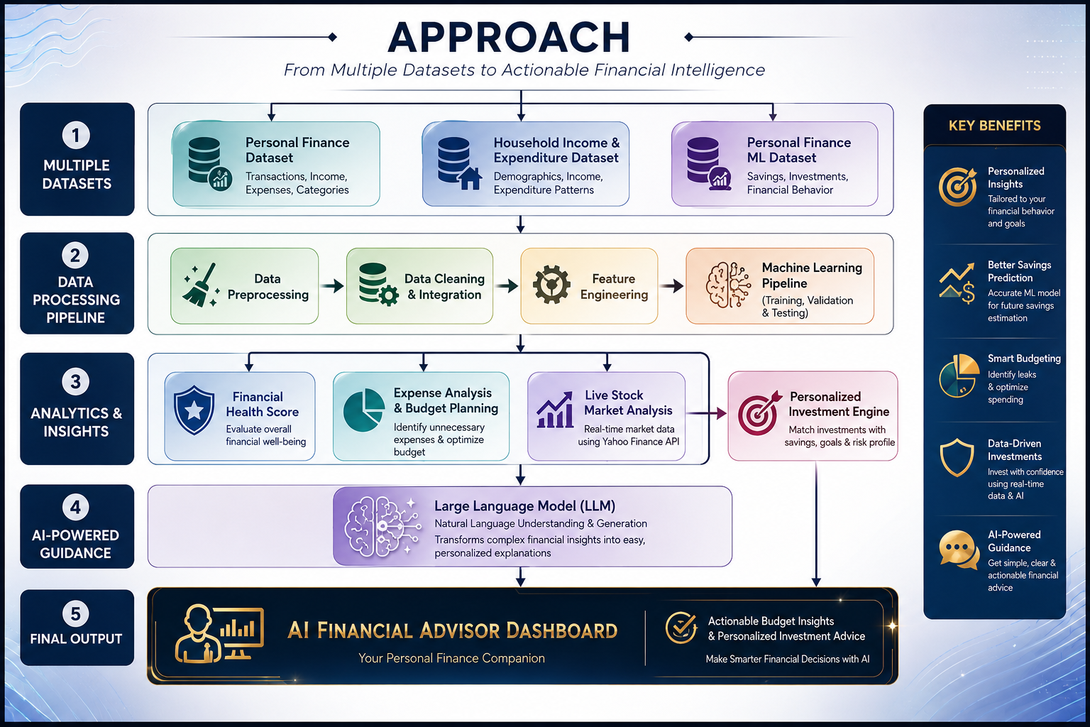
Project Approach

Slide 12
Project Plan
Phase 1: Requirement Analysis & Literature Survey
Phase 2: Dataset Collection & Preprocessing
Phase 3: Machine Learning Model Development
Phase 4: LLM Integration & Investment Recommendation
Phase 5: Frontend, Backend & Dashboard Development
Phase 6: Testing & Performance Evaluation

Slide 13
Target Users
Students – To manage monthly expenses, track spending habits, and improve savings.
Working Professionals – To plan budgets, monitor finances, and receive personalized financial guidance
Freelancers & Self-Employed Individuals – To manage irregular income and forecast monthly savings.
Individuals Seeking Financial Awareness – To understand spending patterns and improve their overall financial health

Slide 14
Thank you

